Slide 1
Alerts Tracker Interface Inventory

Slide 2





Fonts

Slide 3
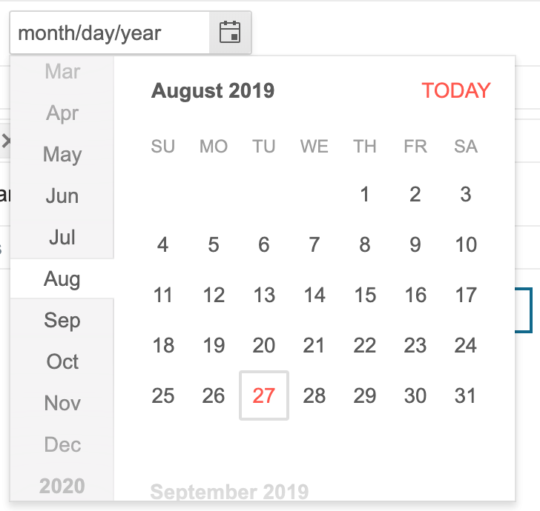
Date/Time Picker

Slide 4
Colors

Slide 5

Tooltips

Slide 6

Breadcrumbs

Slide 7


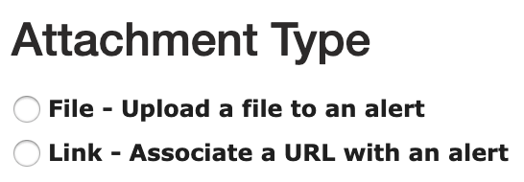



Buttons
Active
Hover
Radio
Disabled

Slide 8


Text boxes

Slide 9





Plus signs

Slide 10






Checkboxes

Slide 11








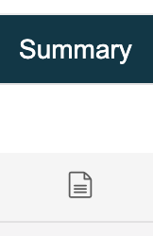

Icons

Slide 12
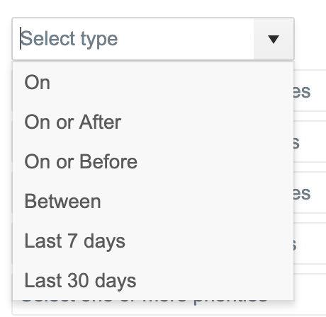

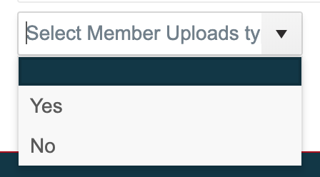



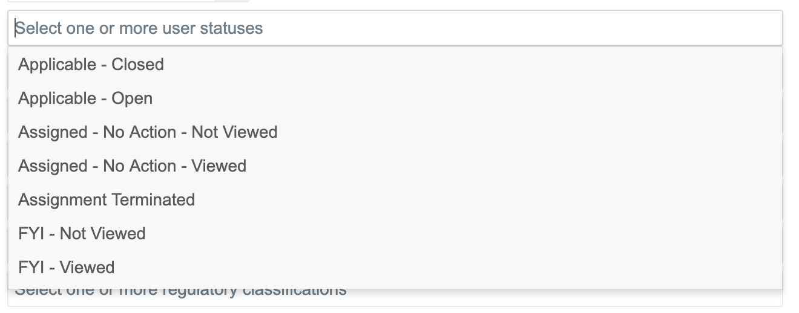
Dropdowns

Slide 13

Dropdowns

Slide 14

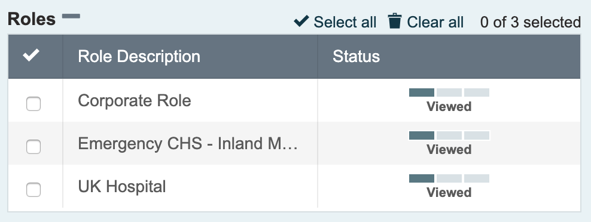
Tables

Slide 15


Tables

Slide 16
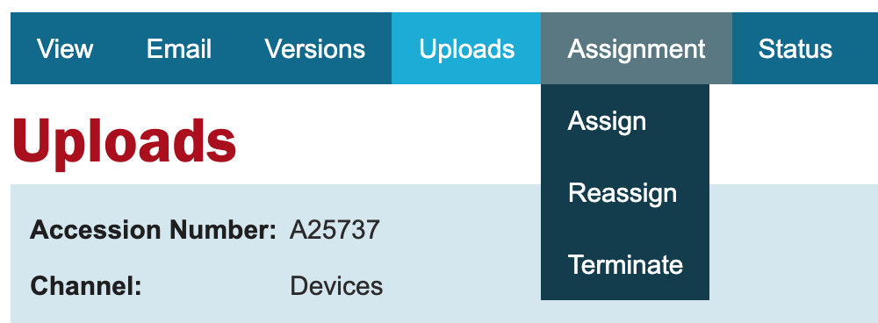

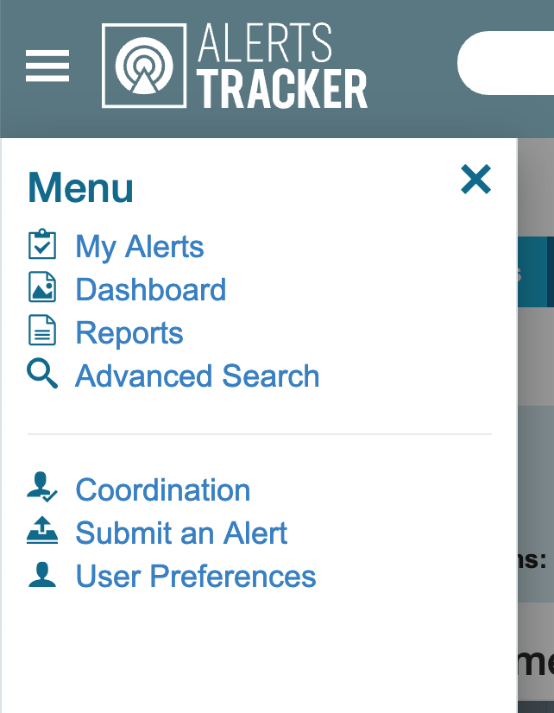


Navigation

Slide 17

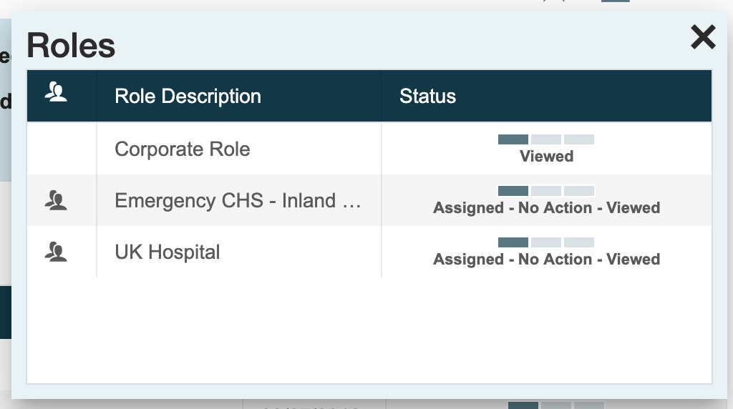

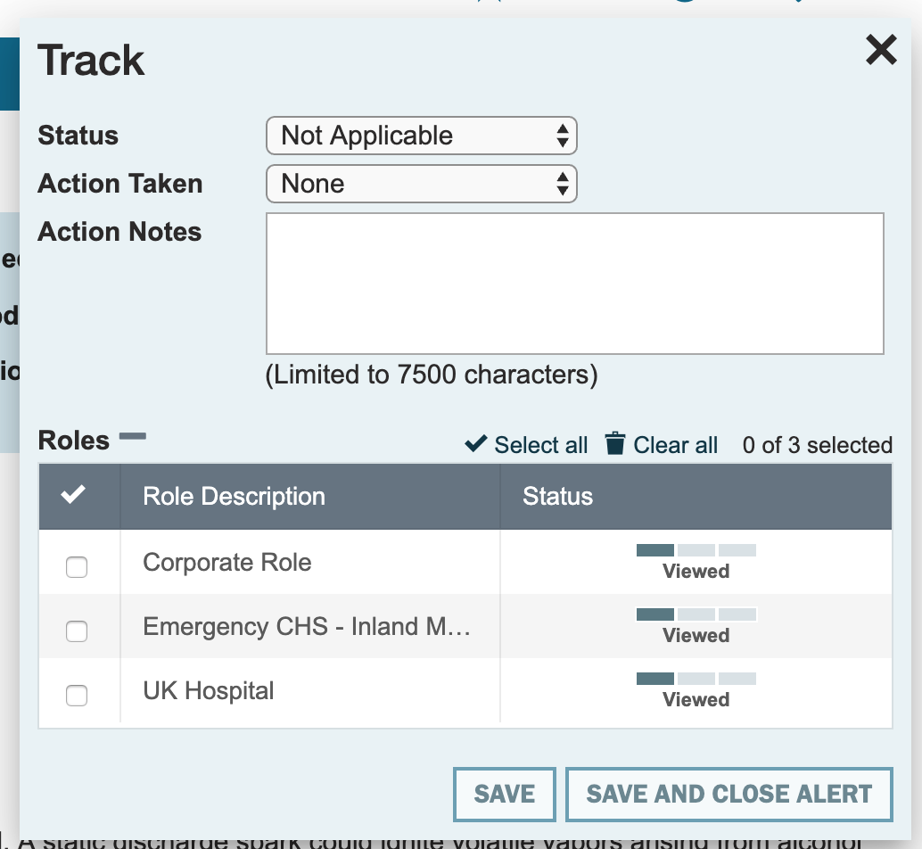
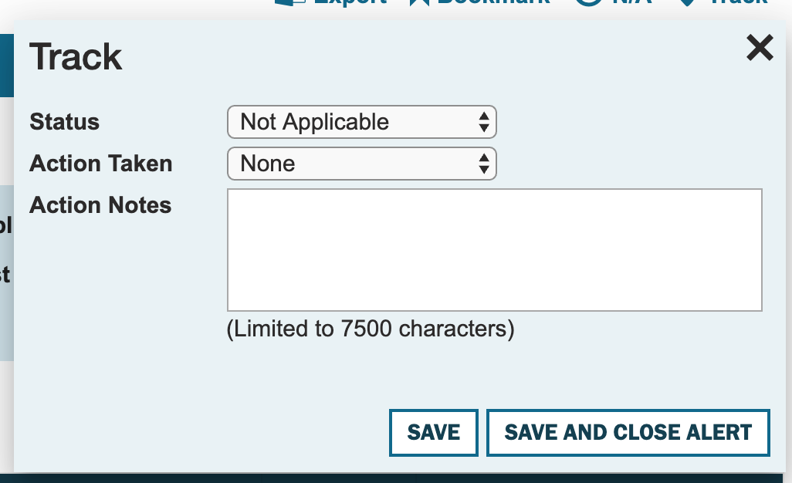
Modals
I didn’t receive an error msg after entering over 7500 characters

Slide 18

Errors

Slide 19
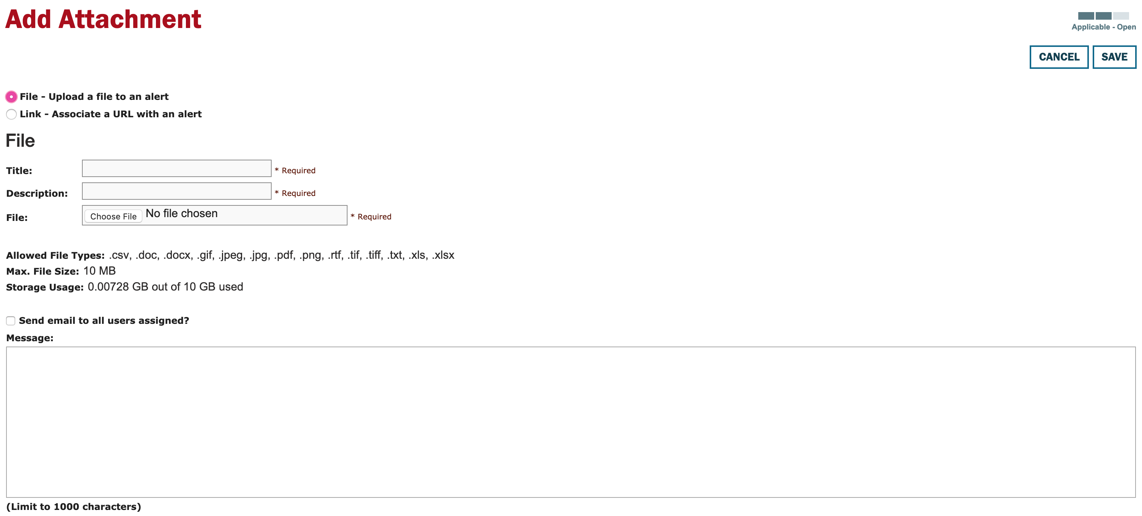
Needs work

